Slide 1
Credit Default Data Challenge
Ming Wang
Data Science Enthusiast
Ph.D. of Mathematics

Slide 2

Outline
Flow chart of the data challenge
Technique points highlight
Demonstration effectiveness of the technique points
Further improvement thoughts

Slide 3
Flow chart of the data challenge (notebook: Credit_Default_Flow.ipynb)
Discover and Visualize the Data to Gain Insights
Prepare the Data for Machine Learning Algorithms
Explore many different methods
Evaluate Model Performance

Slide 4
Highlight of the technique points (notebook: Technique_Highlights.ipynb)
Feature transformation with weight of evidence (WOE)
Under sampling and predictive probability calibration
Bayesian Optimization for hyperparameters tuning
Sort smoothing measurement for the predictive accuracy of probability

Slide 5
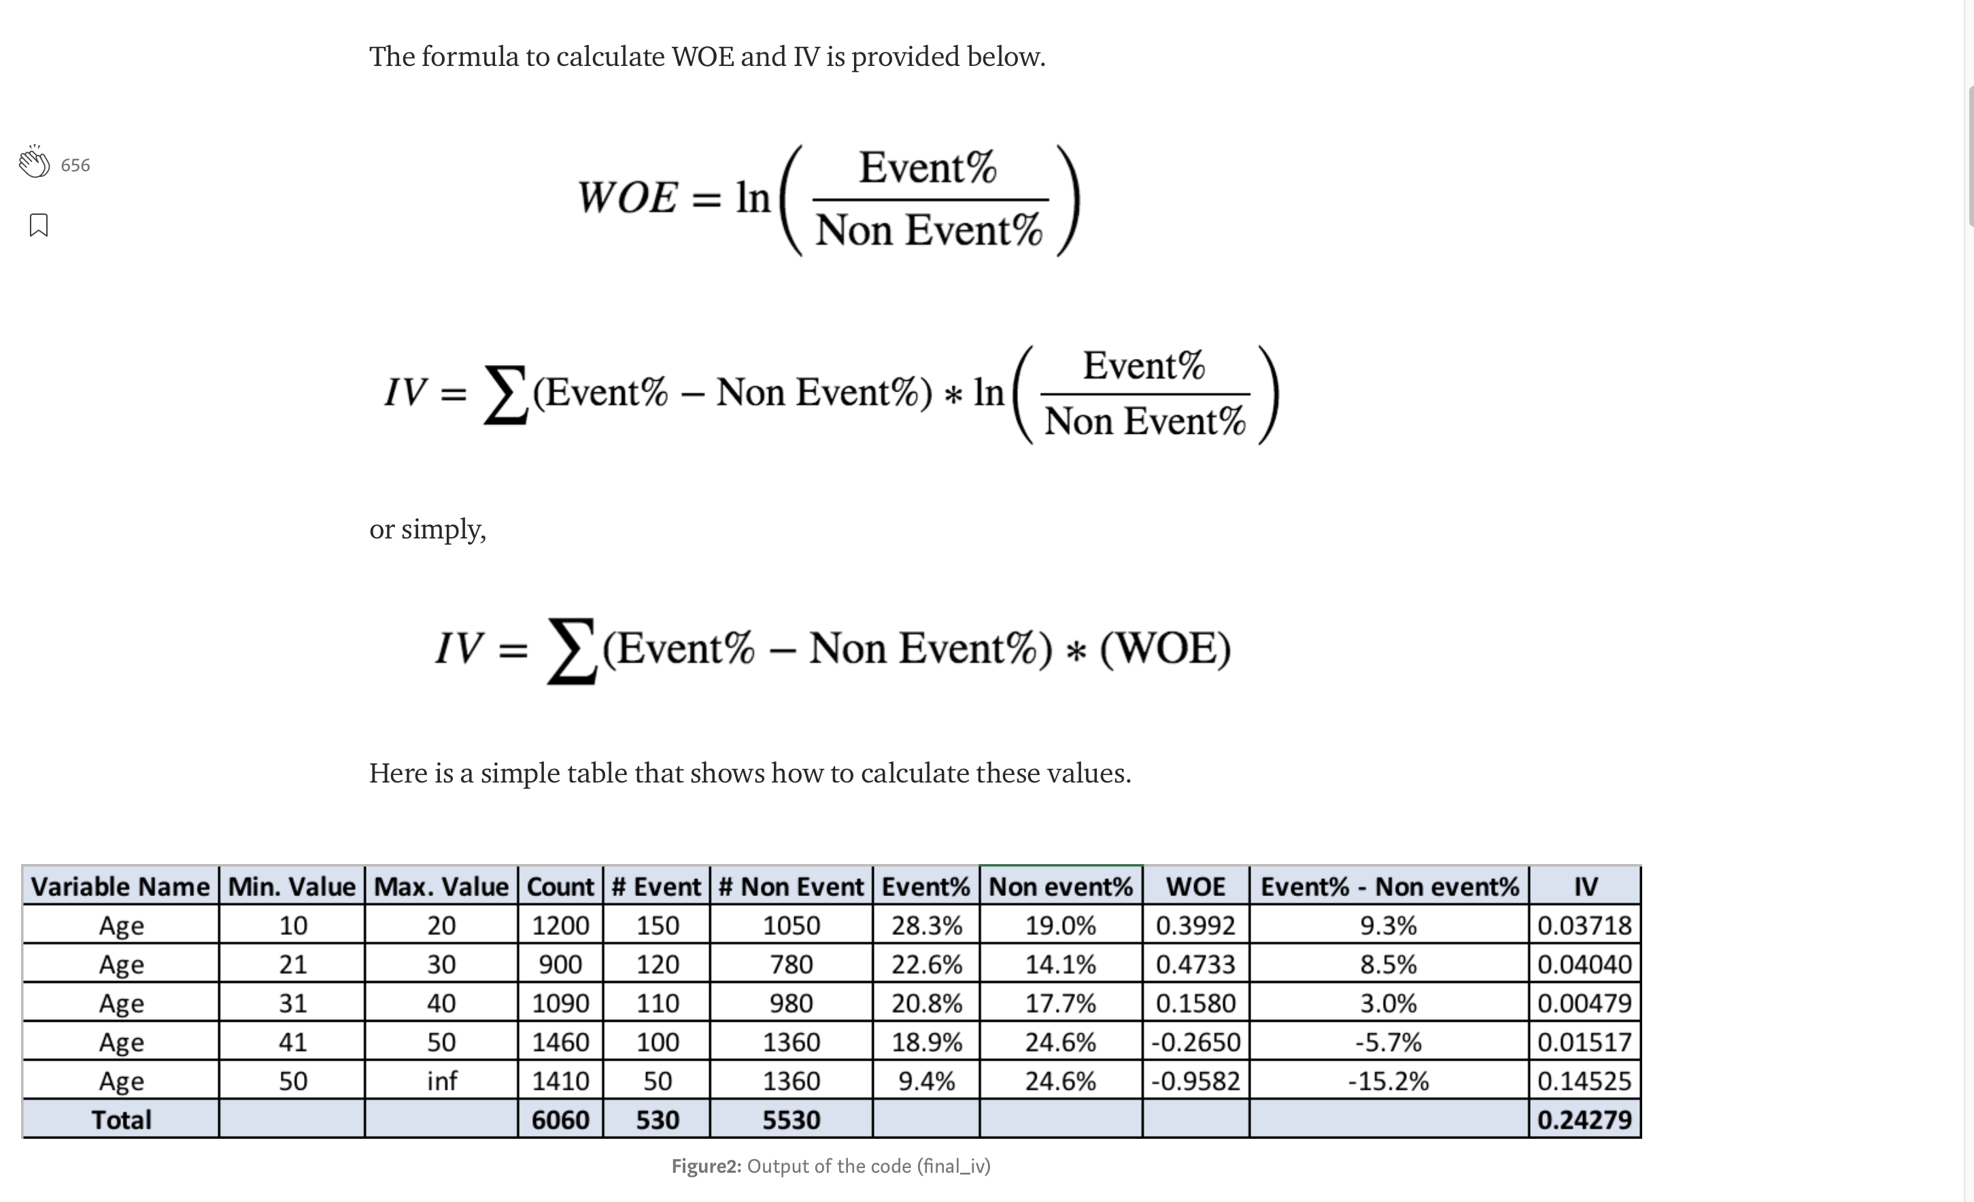
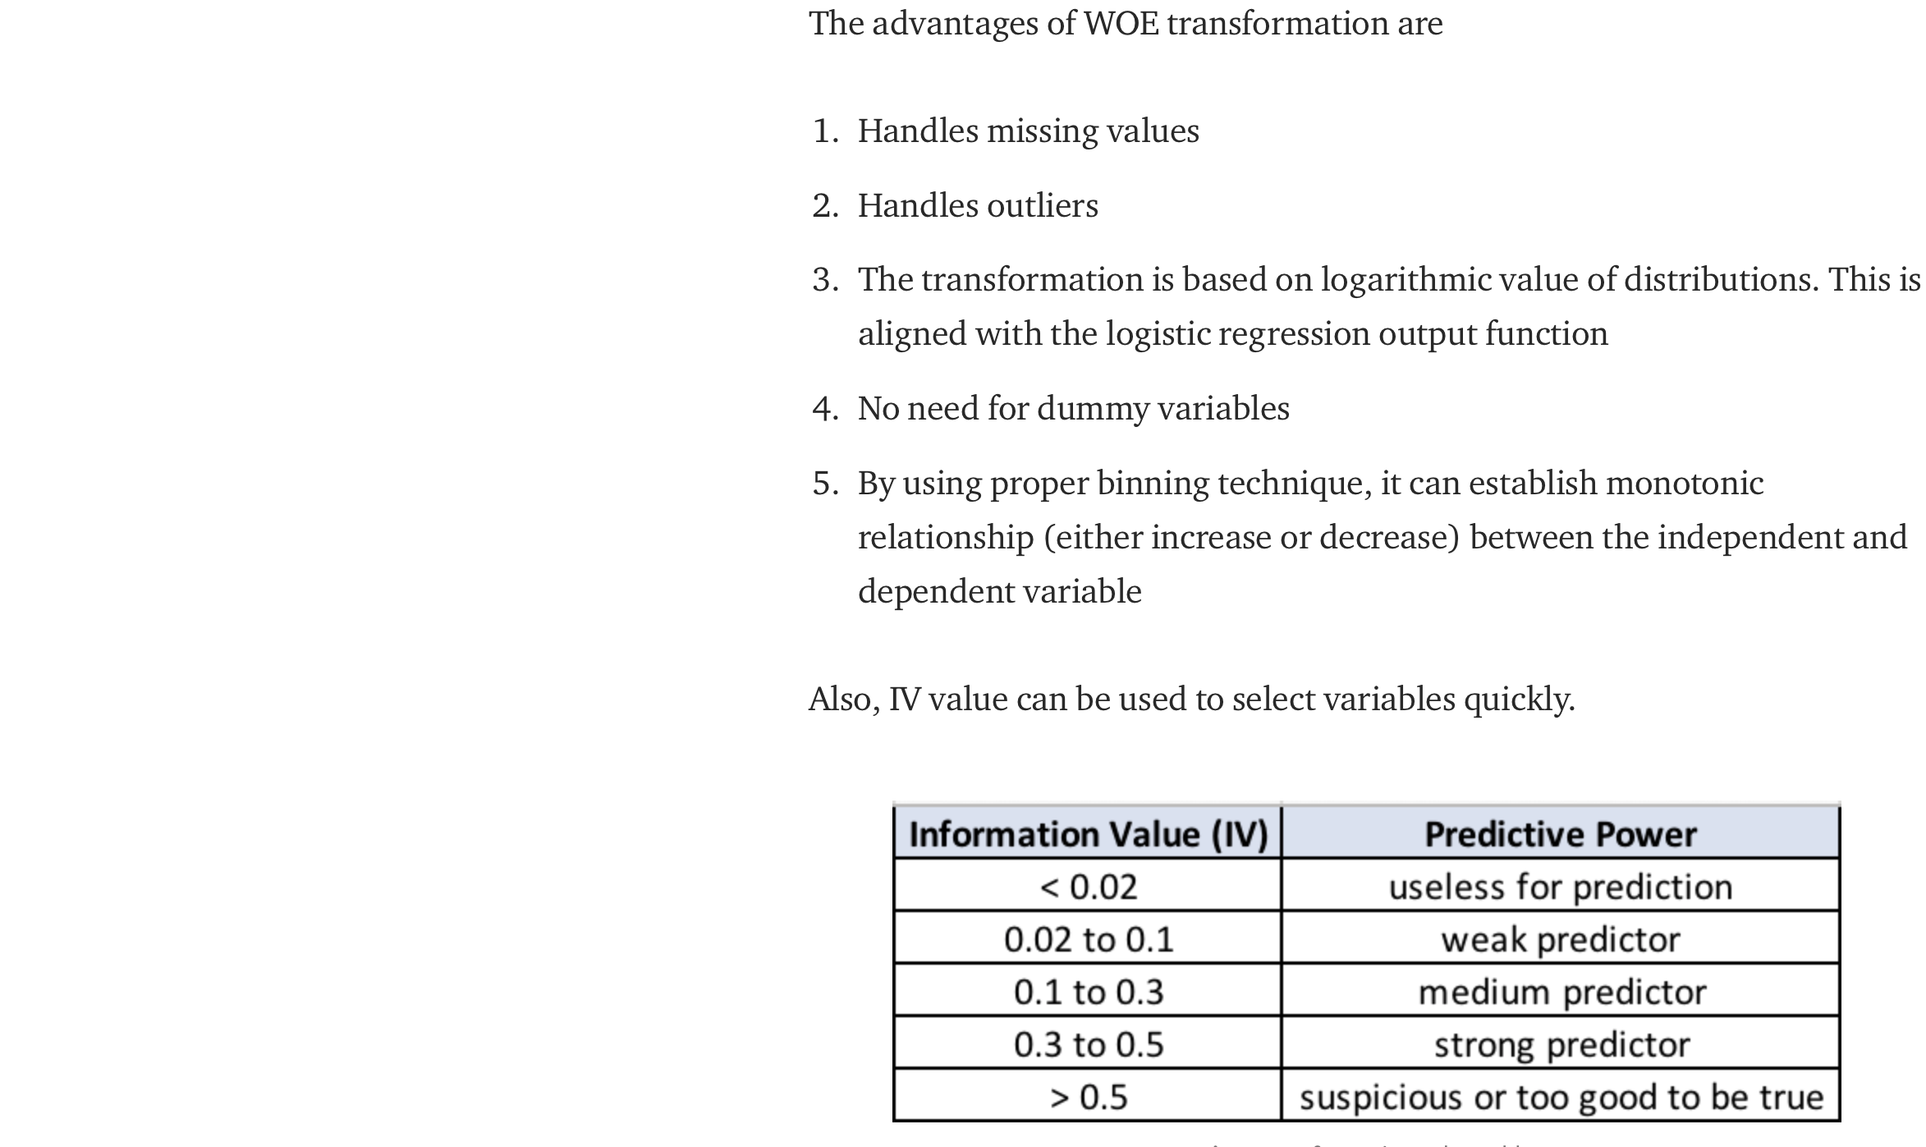
Feature transformation with weight of evidence
Source
https://medium.com/@sundarstyles89/weight-of-evidence-and-information-value-using-python-6f05072e83eb

Slide 6
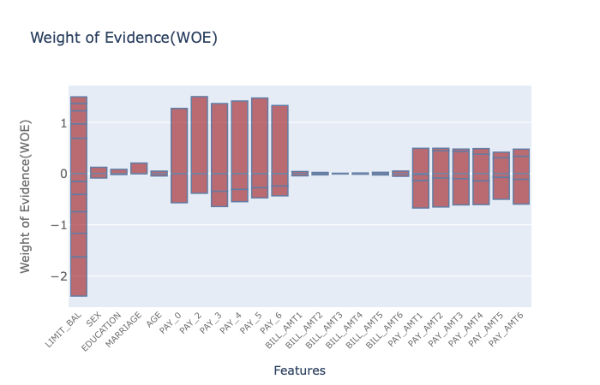
Feature transformation with weight of evidence

Slide 7
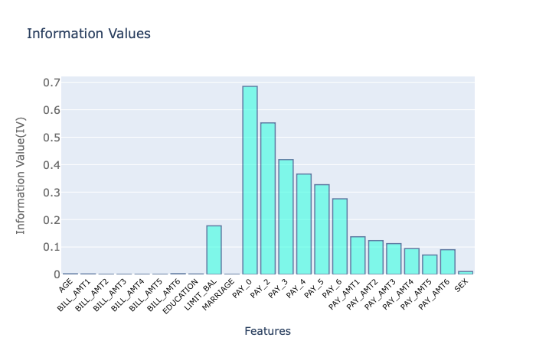
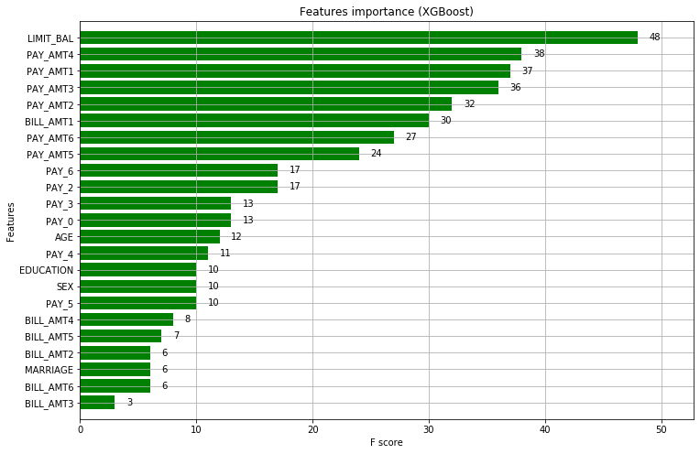
Feature transformation with weight of evidence
Some important features
are similar

Slide 8
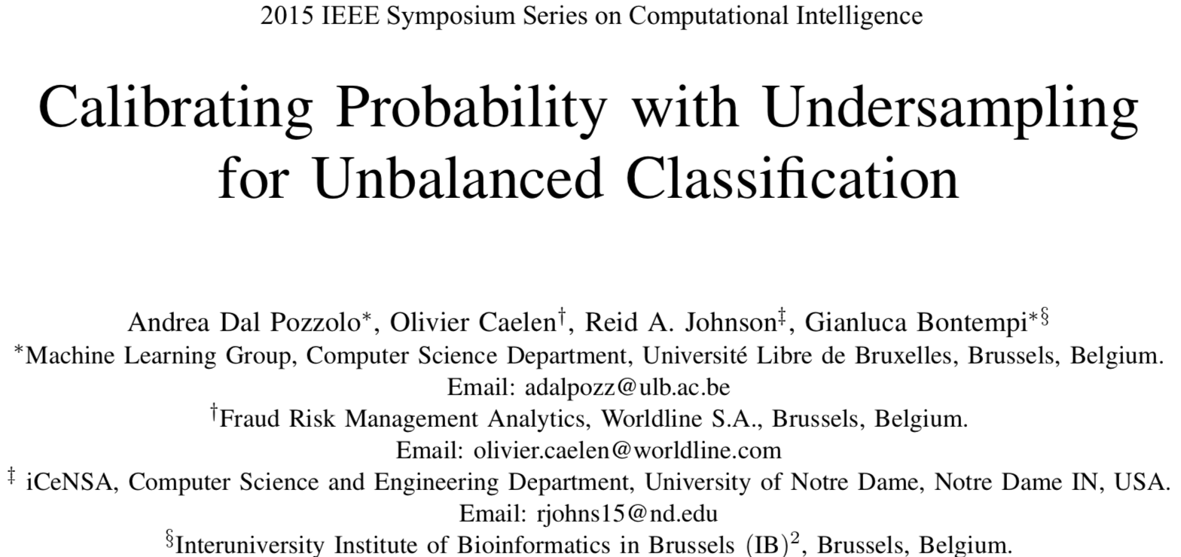
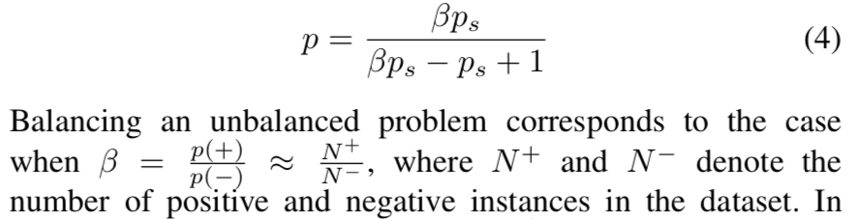
Under sampling and predictive probability calibration
Reference
Computing formula:
P: probability after calibration
Ps: probability before calibration

Slide 9
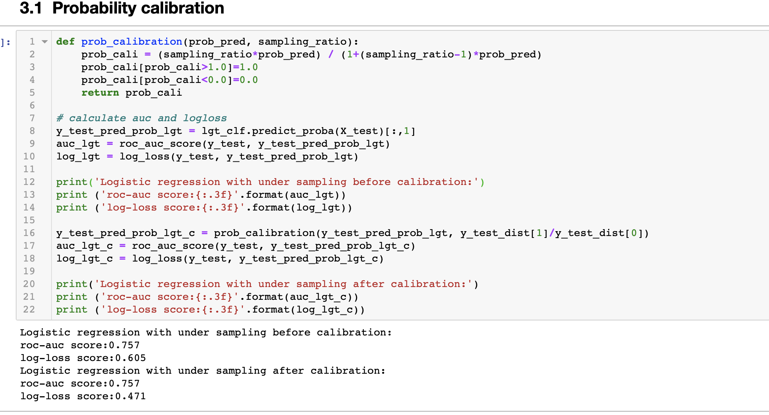
Under sampling and predictive probability calibration
Log-loss turns smaller after calibration
And calibration won’t change roc-auc score

Slide 10
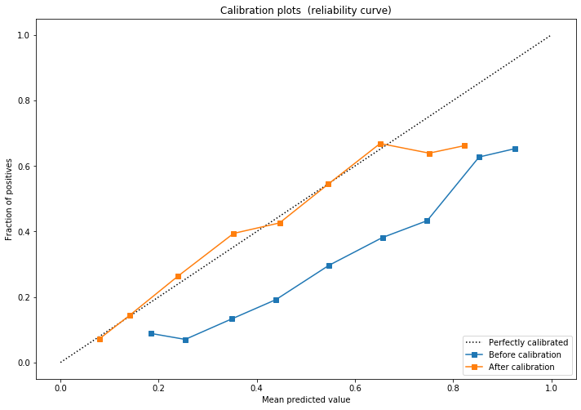
Under sampling and predictive probability calibration
Reliability curve is closer to
y =x line after calibration, which
demonstrates the effectiveness of the
calibration

Slide 11
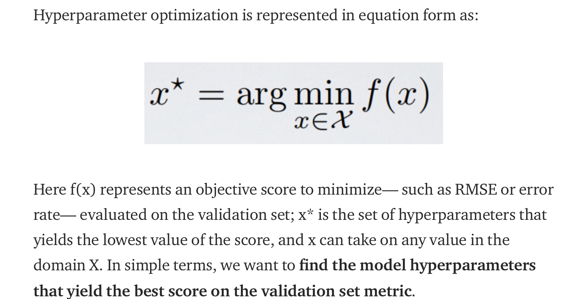
Bayesian Optimization for hyperparameters tuning

Slide 12
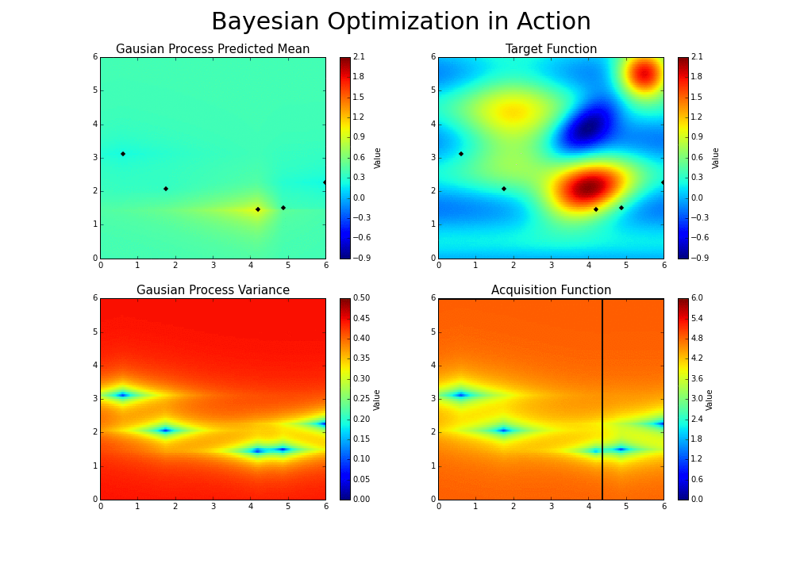
Bayesian Optimization for hyperparameters tuning
https://github.com/fmfn/BayesianOptimization

Slide 13
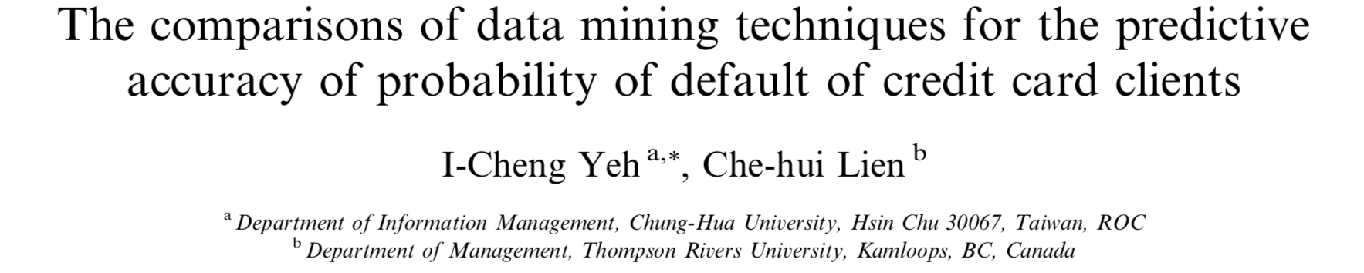
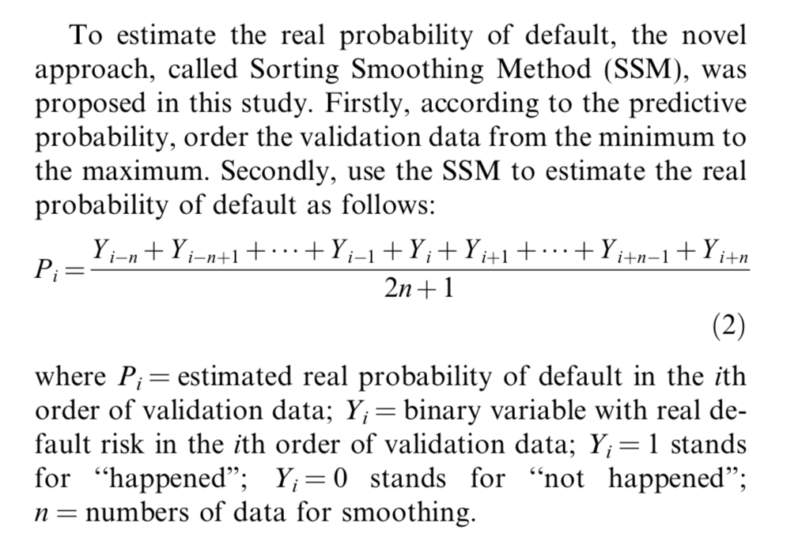
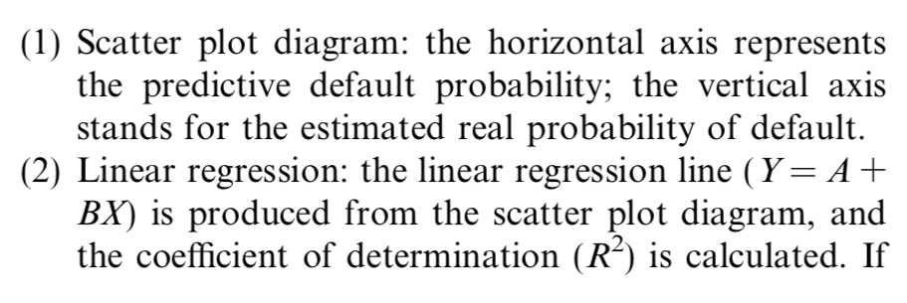
Sort smoothing measurement for the predictive accuracy of probability
Reference
Estimate the real probability:
Plot the figure (shown next slides)

Slide 14
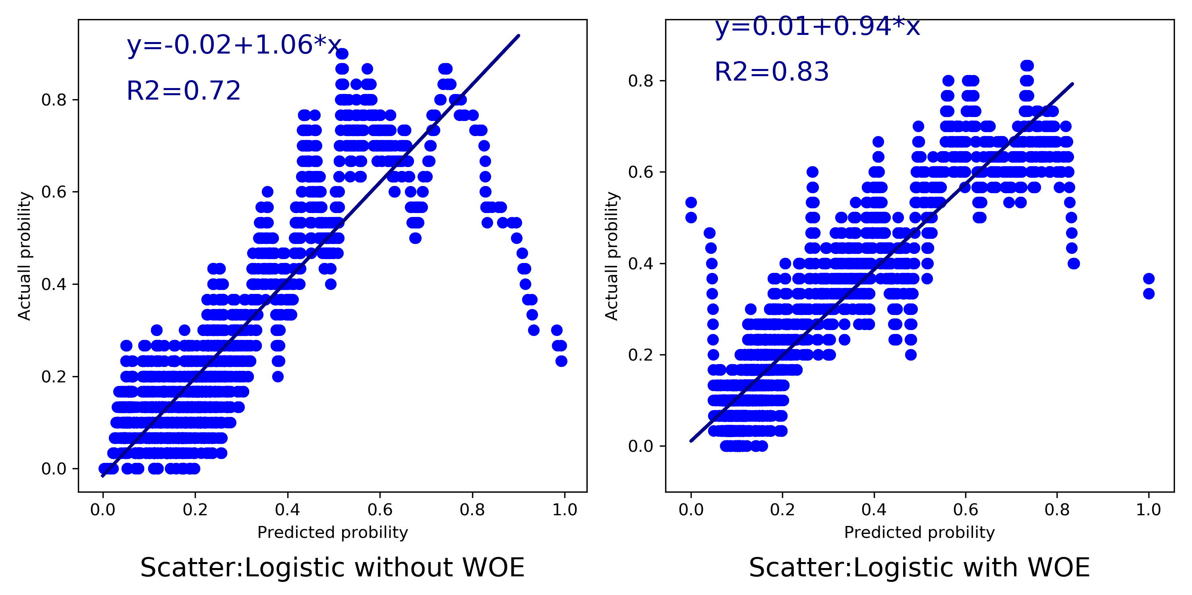
Sort smoothing measurement for the predictive accuracy of probability
The R2 score with
WOE is better than
without WOE
This measurement
is reasonable.

Slide 15
Further improvement thoughts
Gain More understanding on the data
Feature engineering
Missing value imputation using regression
One hot encoding for the categorial variables
Create categories features based on decision tree
Model building
Hyperparameter tuning for neural network
Assembling different models
Compare Bayesian Optimization with grid search and randomized search
Model evaluation
Other predictive probability calibration: Platt’s Scaling and Isotonic Regression

